Slide 1
Introduction to Data Programming Languages
Bob Marshall, MD MPH MISM FAAFP Program Director, DoD/MAMC Clinical Informatics Fellowship

Slide 2
Objectives
Define basic DB languages
Discuss for what uses databases are best
List the major types of databases
Review the following database languages: SQL, R, Python, Java and C++
Provide a closing overview

Slide 3
Some Basic DB Language Definitions
Data Definition Language (DDL): used for specifying the database schema
Data Manipulation Language (DML): used for accessing and manipulating data in a database
Data Control language (DCL): used for granting and revoking user access on a database
Data definition language, data manipulation language and data control languages are not separate languages; parts of a single database language

Slide 4
What are Databases Good For?
A database is an organized collection of data, stored and accessed electronically
A set of related data and the way it is organized
Databases support internal operations of organizations and underpin online interactions with customers and suppliers
Databases hold administrative information and more specialized data, such as engineering data or economic models
In healthcare, databases underlie all EHR’s, PACS, document management systems, billing systems, Pharmacy systems, etc

Slide 5
Major Types of Databases
Relational databases
SQL databases
Object-oriented databases
NoSQL and NewSQL databases
A quick, easy read on different types of databases:
https://en.wikipedia.org/wiki/Database

Slide 6
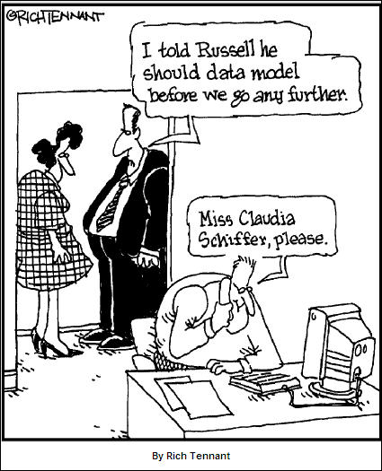

Slide 7
Common Database Programming Languages
SQL
R
Python
Java
C++
Rust
Scala

Slide 8
SQL 1 of 2
In 1969, IBM researcher Edgar F. Codd defined the relational database model, which became the basis for the SQL language
A few years later, based on Codd’s work, IBM released System R, now known as SQL.
SQL is typically easier to learn than Java, C++, PHP or C#
SQL is still the most popular and widely implemented database language
SQL can be used to share and manage data, particularly data in relational database management systems, which include data organized into tables

Slide 9
SQL 2 of 2
SQL has several iterations, one of which is MySQL, now owned by Oracle
MySQL is open-source
Simple SQL commands like SELECT, ORDER BY and INSERT help administrators to route data in and out of a database table
SQL requires data to be organized in tables and does not “scale infinitely”
This has led to the NoSQL systems for extremely large, non-tabled data

Slide 10
R 1 of 3
R is a programming language and free software environment for statistical computing and graphics supported by the R Foundation for Statistical Computing
R is widely used among statisticians and data miners for developing statistical software and data analysis
The source code for the R software environment is written primarily in C, Fortran and R
While R has a command line interface, there are several graphical front ends, most notably RStudio and RStudio Server

Slide 11
R 2 of 3
R was created by Ross Ihaka and Robert Gentleman at the University of Auckland, New Zealand
Project conceived in 1992; initial version released in 1995; stable beta version in 2000; current version is 3.5 (April 2018)
R and its libraries implement a wide variety of statistical and graphical techniques, including linear and nonlinear modeling, classical statistical tests, time-series analysis, classification, clustering, and others
R is easily extensible through functions and extensions

Slide 12
R 3 of 3
For computationally intensive tasks, C, C++, and Fortran code can be linked and called at run time
Advanced users can write C, C++, Java, .NET or Python code to manipulate R objects directly
R has stronger object-oriented programming facilities than most statistical computing languages
Another strength of R is static graphics, which can produce publication-quality graphs, including mathematical symbols.
Dynamic and interactive graphics are available through additional packages

Slide 13
Python 1 of 3
Python is an interpreted high-level programming language for general purpose programming
Created by Guido van Rossum and first released in 1991, Python has a design philosophy that emphasizes code readability, notably using significant whitespace.
It provides constructs that enable clear programming on both small and large scales
Python features a dynamic type system and automatic memory management

Slide 14
Python 2 of 3
It supports multiple programming paradigms, including object-oriented, imperative, functional and procedural, and has a large and comprehensive standard library
Rather than having all of its functionality built into its core, Python was designed to be highly extensible
While offering choice in coding methodology, the Python philosophy rejects exuberant syntax (such as that of Perl) in favor of a simpler, less-cluttered grammar
An important goal of Python's developers is keeping it fun to use

Slide 15
Python 3 of 3
Meant to be an easily readable language
Uses whitespace indentation, rather than curly brackets or keywords, to delimit blocks
Most implementations include a read–eval–print loop (REPL), permitting them to function as a command line interpreter for which the user enters statements sequentially and receives results immediately
Can serve as a scripting language for web applications
Widely used in bigger organizations because of its multiple programming paradigms

Slide 16
Comparing R and Python 1 of 2
R makes you think more in a functional way
R offers just a bunch of structures out of the box
Indexing in R is quite intuitive for Excel people and quite horrible for anyone with Computer Science background
R is kind enough to use curly braces
Python lets you be object-oriented
Python offers a wide range of data structures
The Zen of Python is that there’s one proper way to do something…not so with R
No curly braces…whitespace only

Slide 17
Comparing R and Python 2 of 2
R makes you feel there’s almost nothing between you and your data in a way that almost no other data language does, but it can lead you into piles of clutter
In R, indexing starts at 1
Functional or data chaining in R makes it hard to read
Python code, being object-oriented, tends to remain organized at a bit larger scale, but it is still limited by its dynamic typing nature
In Python, indexing starts at 0
The best way to write ugly, low-performant R code is to write it as Python code

Slide 18
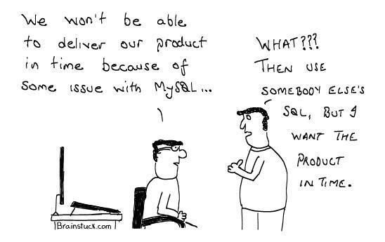

Slide 19
Java 1 of 4
Java is a general-purpose computer-programming language that is concurrent, class-based, object-oriented, and specifically designed to have as few implementation dependencies as possible
It is intended to let application developers "write once, run anywhere" (WORA), meaning that compiled Java code can run on all platforms that support Java without the need for recompilation
Java applications are typically compiled to bytecode that can run on any Java virtual machine (JVM) regardless of computer architecture
Originally developed by James Gosling at Sun Microsystems and released in 1995

Slide 20
Java 2 of 4
Derives much of its syntax from C and C++, but it has fewer low-level facilities than either of them
Java software runs on everything from laptops to data centers, game consoles to scientific supercomputers
The Java language is a key pillar in Android
Although Android, built on the Linux kernel, is written largely in C, the Android SDK uses the Java language as the basis for Android applications

Slide 21
Java 3 of 4
Types of applications that run on Java:
Desktop GUI applications
Mobile applications
Embedded systems
Web applications
Web servers and application servers
Enterprise applications
Scientific applications

Slide 22
Java 4 of 4
Enterprise Applications
Java Enterprise Edition (Java EE) is a popular platform that provides API and runtime environment for scripting and running enterprise software
High frequency trading systems like Murex have been scripted in the Java
It is also the backbone for a variety of banking applications which have Java running from front user end to back server end
Scientific applications
Java is the choice of many software developers for writing applications involving scientific calculations and mathematical operations
These programs are generally considered to be fast and secure, have a higher degree of portability and low maintenance

Slide 23
C++ 1 of 2
C++ is a general-purpose object-oriented programming (OOP) language, developed by Bjarne Stroustrup, and is an extension of the C language
C++ is considered to be an intermediate-level language, as it encapsulates both high- and low-level language features
The main highlight of C++ is a collection of predefined classes, which are data types that can be instantiated multiple times
C++ includes several operators such as comparison, arithmetic, bit manipulation and logical operators

Slide 24
C++ 2 of 2
Creating databases in C++ is very challenging, but it can be done
A number of very powerful databases are based on C++, including SQL Server and Azure DB
Because C++ is powerful, fast, reliable and secure, it is a very common and preferred programming language, though not as popular as Java

Slide 25
Closing
There are a number of programming languages that are used for database creation, management and reporting/data extraction
Some are essentially purpose-built for that use, like R and SQL
Others have broader use, but are still excellent for databases, like Java and Python
C++ is very powerful, and it can be used for databases, but it is much more challenging to use for that purpose than the others
If you are a data scientist, R is your go-to language
If you want an easy, powerful language, and you want to publish to the Web, Python is probably your language of choice

Slide 26
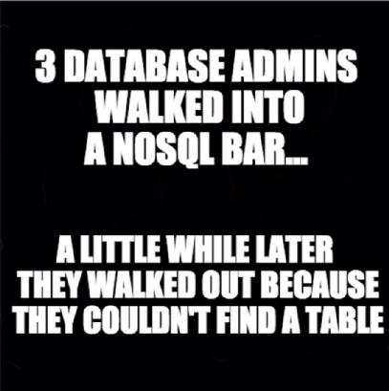
Questions/Comments

